Slide 1
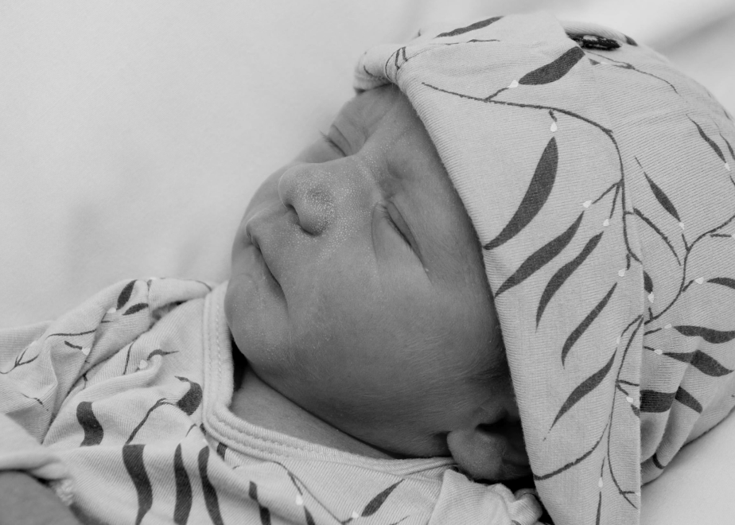
Knight’s Wireless Baby Monitor
Keeping our babies safe!

Slide 2
Group Information Team 5
Members: |  |  |  |  |  | Mentors:
Jaoaud Annoni (EE) |  |  |  |  |  | Zaza Soriano, EE, CpE
Theresa Moyo (EE) |  |  |  |  |  | Dino Soriano, RN
Hanyun Wang (EE)
Dan Zuber (CpE)
 |  |  | Sponsor: Boeing

Slide 3
Objectives
Build a reliable baby monitor for infants under one year old to monitor the infant and keep it out of hazardous positions known to be associated with SUID and SIDS.
Monitor motion, body heat of the infant with the temperature and sound of the environment.
Alert the caretaker and parents of life threatening events.
Enable the parents to monitor the babies environment via their smart phones.
Ability to add remote sensors in the future to monitor the heart rate and babies temperature.

Slide 4
System Specifications
System Specifications
Monitoring unit no larger than 8” wide x 12” deep x ¾ “ thick
The monitoring unit shall operate for 10 hours on rechargeable batteries.
The minimum broadcast range from the transmitter to the wireless receiver will be 40 meters.
The alarm unit shall always be activated by rechargeable batteries lasting 8 hours on one charge.

Slide 5
Overall System

Slide 6
Motion sensor

Slide 7


Induction distance
24 hours
Size
Buzzer
Move too often
Don’t move
sensor
motion sensor
cell phone

Slide 8
 | Adjustable distance | Induction distance | Size | Infrared (24 Hours) | Delay time | Triggering
Mini IR sensor |  | <3m | 10 x 23 mm | infrared |  | Repeated triggering
Security Hi-Q |  | 3-5 | 28 x 28 x 26 mm | infrared |  | Repeated triggering
New R1 |  | 5-8m | 6.3 x 3.8 x 2.8cm | infrared | 30s
HC-SR501 | yes | 0-7m | 24x34mm | infrared | 0- tens of seconds | Repeated trigger/can not repeated

Slide 9
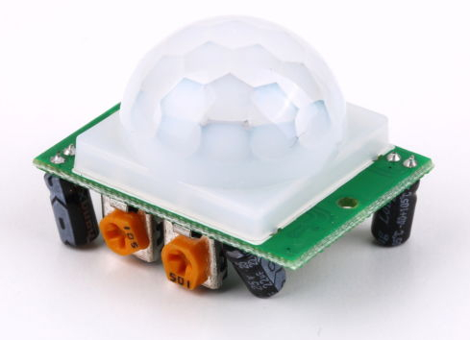
HC-SR501 Infrared PIR Motion Sensor Detector Module
Infrared sensor
Control circuit board
32mm
24mm
Basic Specification
Detection distance: | Delay time | Working voltage | Voltage output
0-7M | 0.5-200s | DC 4.5V – 20V | High/Low output : 3.3V/0V

Slide 10
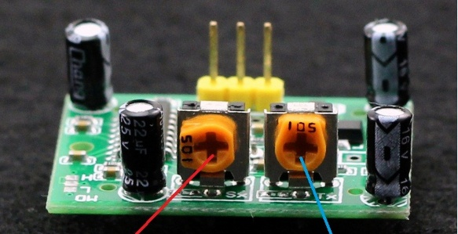
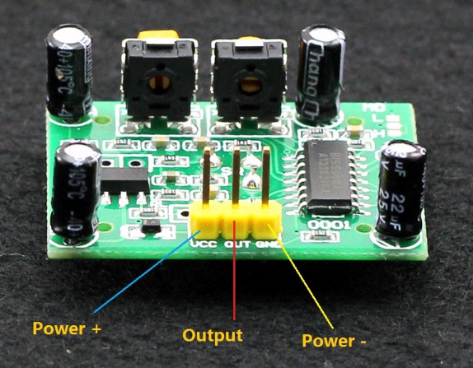
Potentiometer
Input
Ground
Output
Adjust distance
Clockwise = increase 7m
Anticlockwise= decrease 0m
Adjust delay time
Clockwise=longer delay
Anticlockwise=shorter delay
Output voltage:
to enter the sensor output range is high, people leave the sensor range of the automatic delay off high, output low

Slide 11
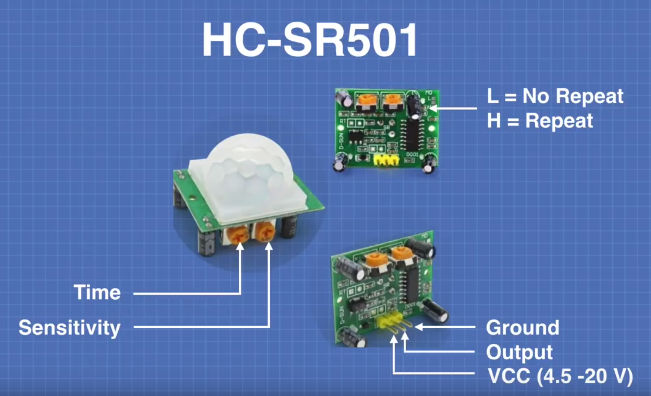

Slide 12
Basic features
Induction blocking time(default setting:2.5s)
After output, we can set the blocking time, and the motion sensor will stop working in the blocking time
two trigger mode:
A or L: can not repeat the trigger
B or H: repeatable trigger: If some move object move in the sensing range, The motion sensor will work after the delay time.

Slide 13
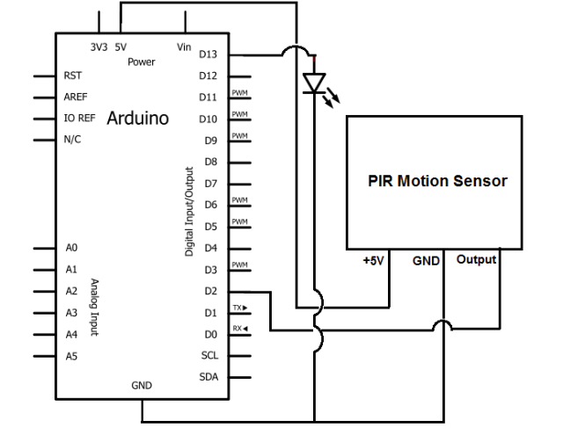
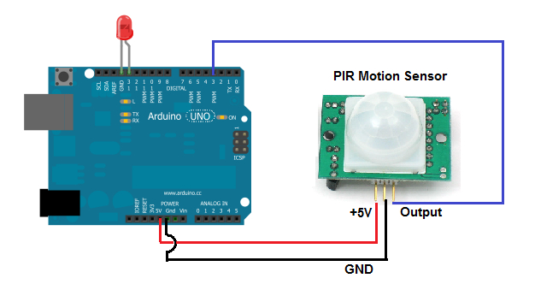
Connect to the board
Microcontroller
Microcontroller

Slide 14
References:
https://components101.com/hc-sr501-pir-sensor
https://www.mpja.com/download/31227sc.pdf
http://henrysbench.capnfatz.com/henrys-bench/arduino-sensors-and-input/arduino-hc-sr501-motion-sensor-tutorial/

